Slide 1
Approaching the Singularity
Harlen Hays – Manager | Lead Analytics Advisory Consultant
&
Morgan Fuller – Senior Data Analyst
06/05/2019

Slide 2
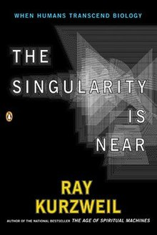
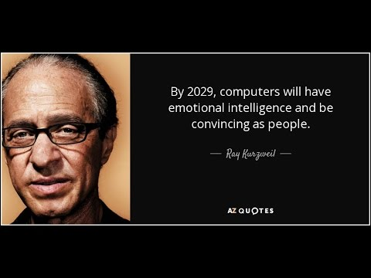
“What is the Singularity? It’s a future period during which the pace of technological changes will be so rapid, its impact so deep, that human life will be irreversibly transformed”
- Ray Kurzweil

Slide 3
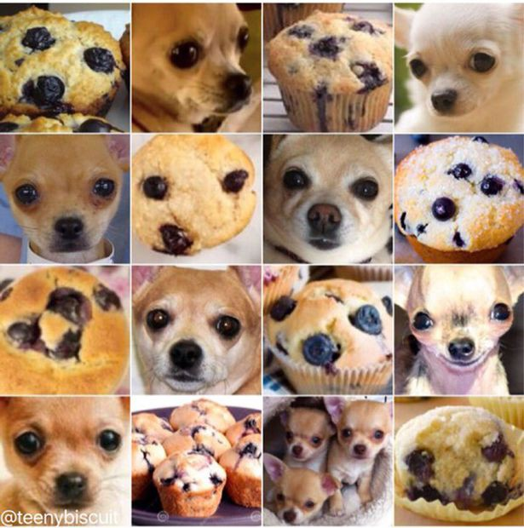
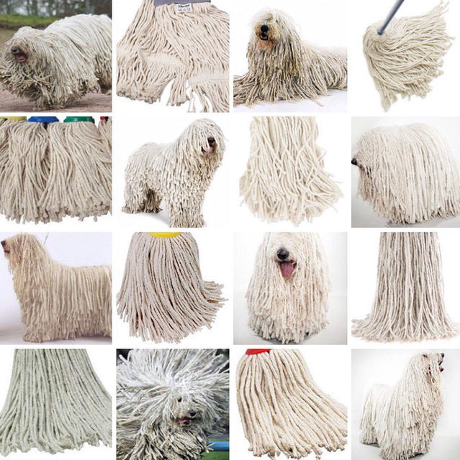
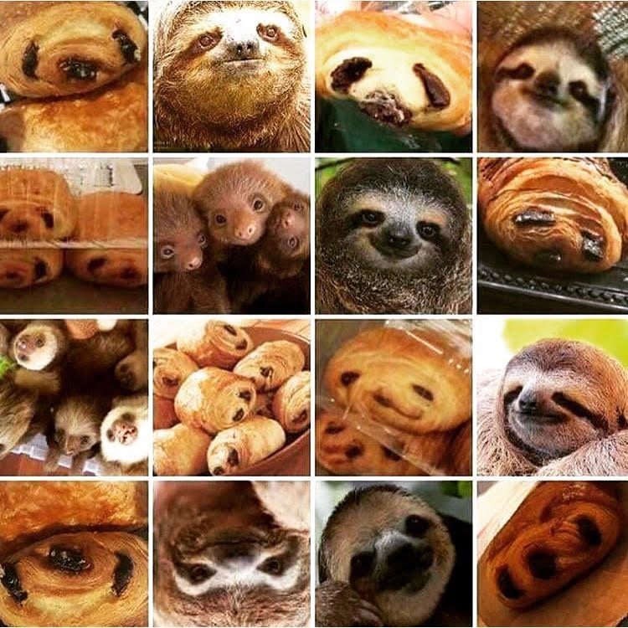

Slide 4
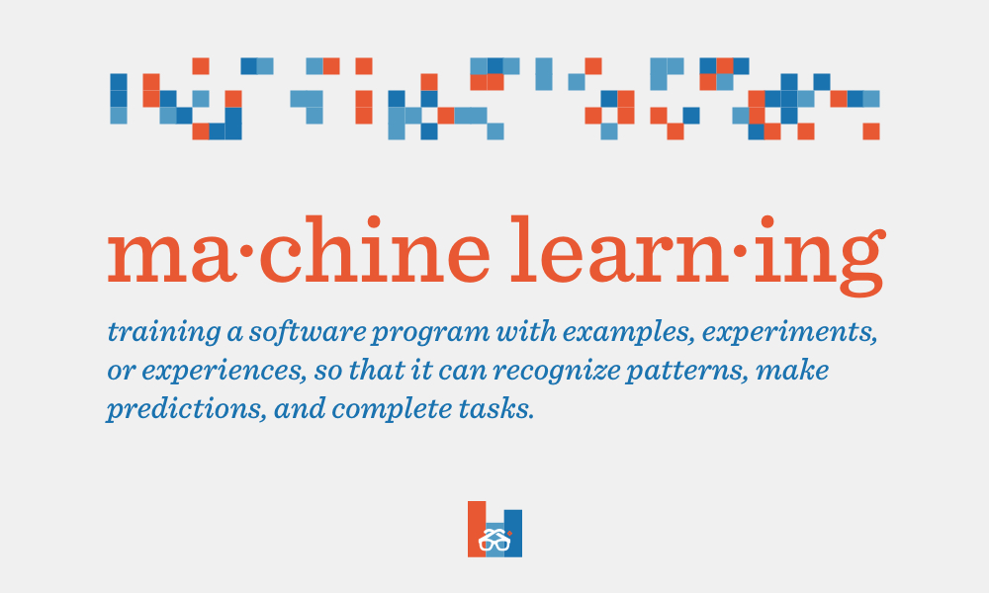
Source: https://blog.degreed.com/degreed-does-data-machine-learning/

Slide 5
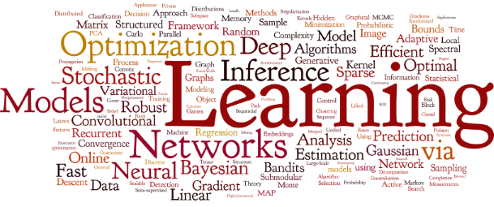
Recipe for Supervised Learning
Source: https://bit.ly/317kRWO

Slide 6
The defining method
Create the Model
Identify the algorithm of choice for this iteration
Tune the model to the specifications you’ve identified (start with standard set)
Fit the Model
Converge the model using the TRAINING data set
Save the newly built model to be validated
Validate the Model
Challenge the data with the TEST data set to create predictions
Compare predictions to the actuals to determine key metrics (accuracy, bias, recall)
No data is used at this point
Determine if additional tuning is needed

Slide 7
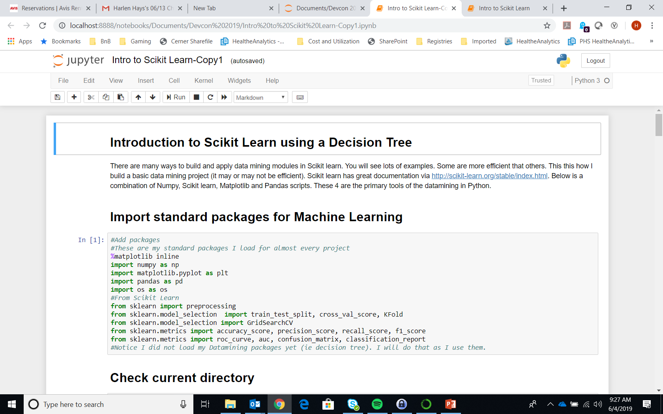
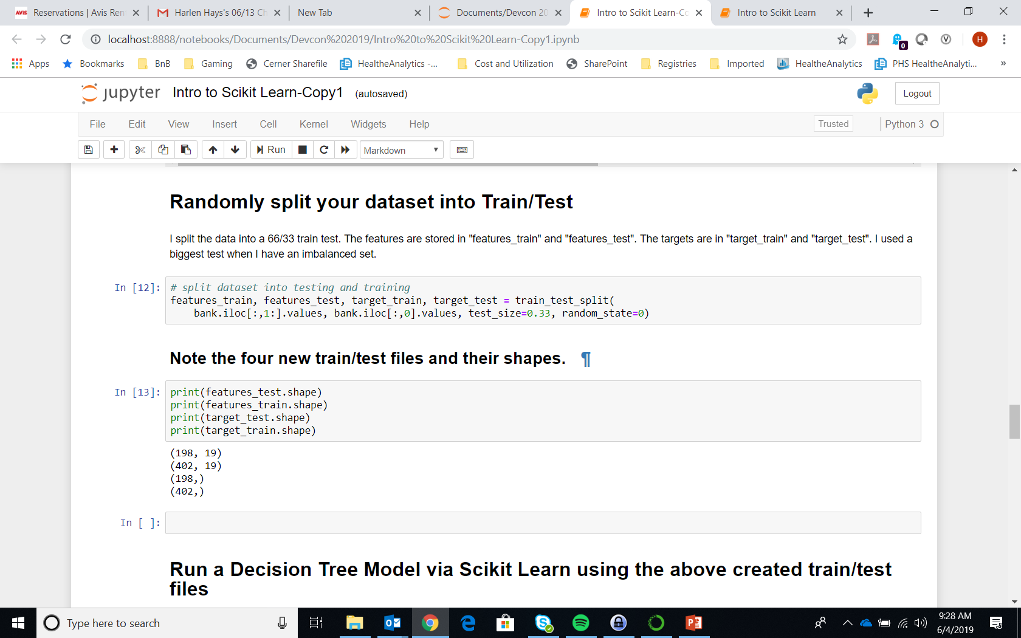
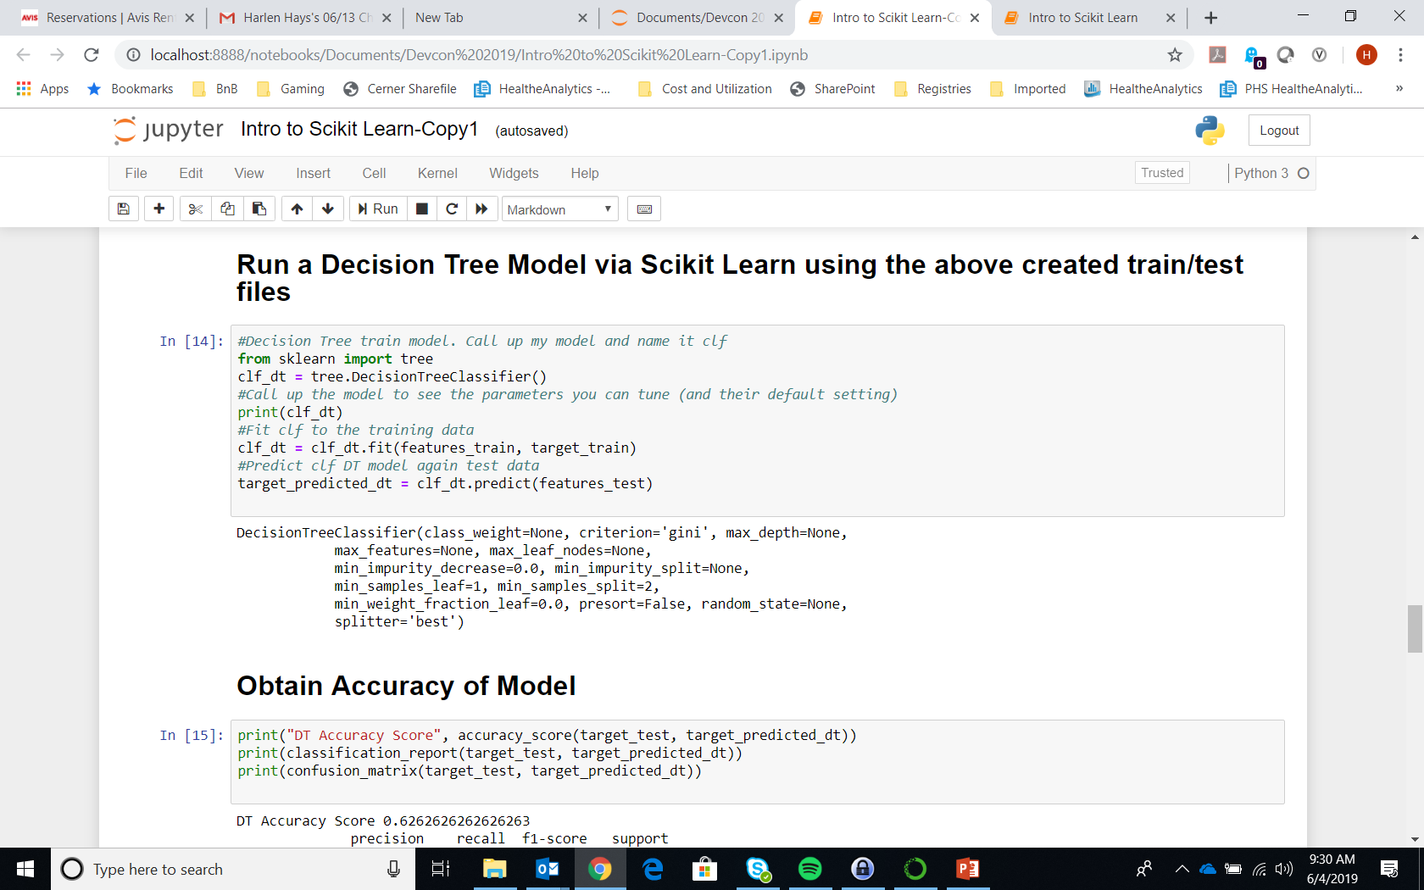
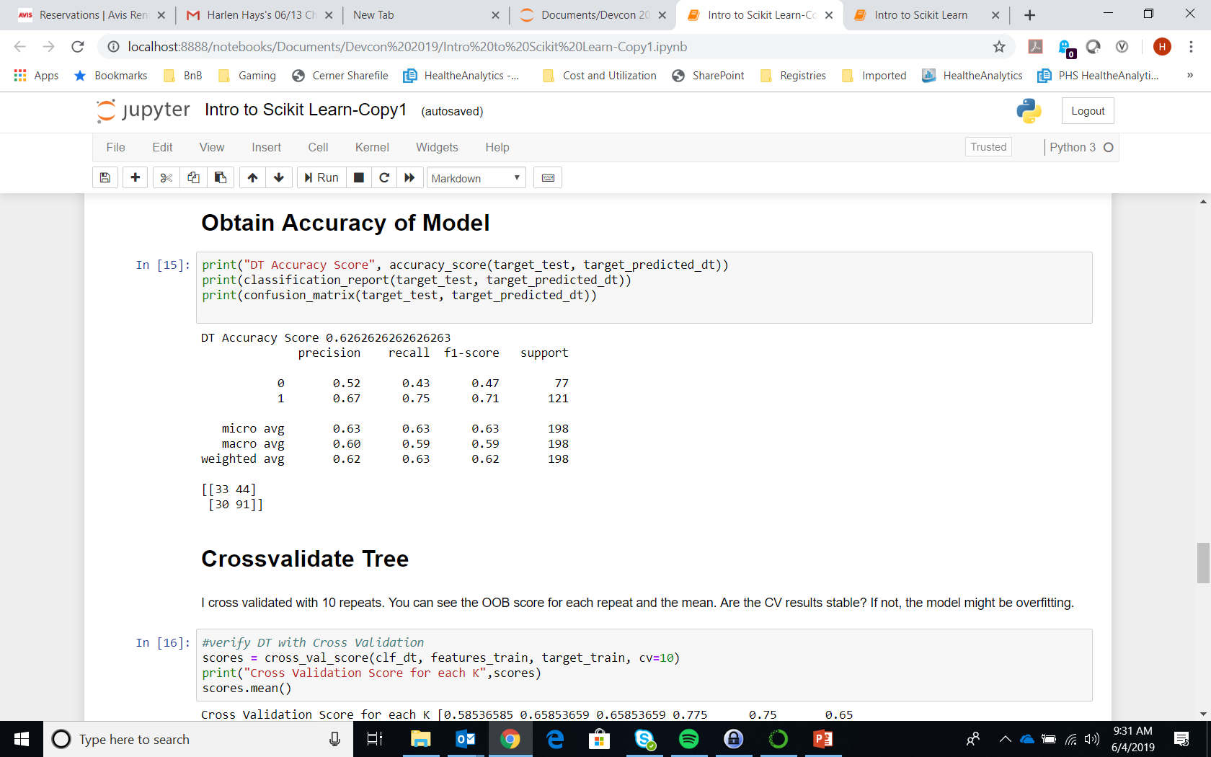
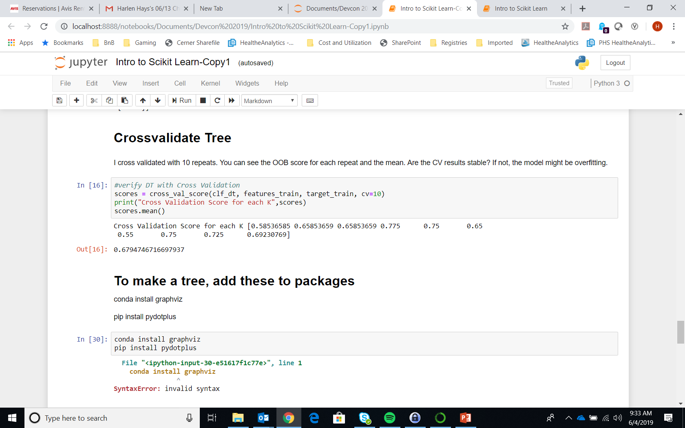
Code in action

Slide 8
Classification/Predicting by ANN
A neural network learning algorithm
Started by psychologists and neurobiologists to develop and test computational analogues of neurons
Much like conventional learning, repetition and diversity are key
A neural network: A set of connected input/output units where each connection has a weight associated with it
These weights have no meaningful interpretation, they can significantly change based on where you start in the data
The user determines how many connections will be created by determining layers and inputs
During the learning phase, the network learns by adjusting the weights so as to be able to predict the correct class label of the input tuples

Slide 9
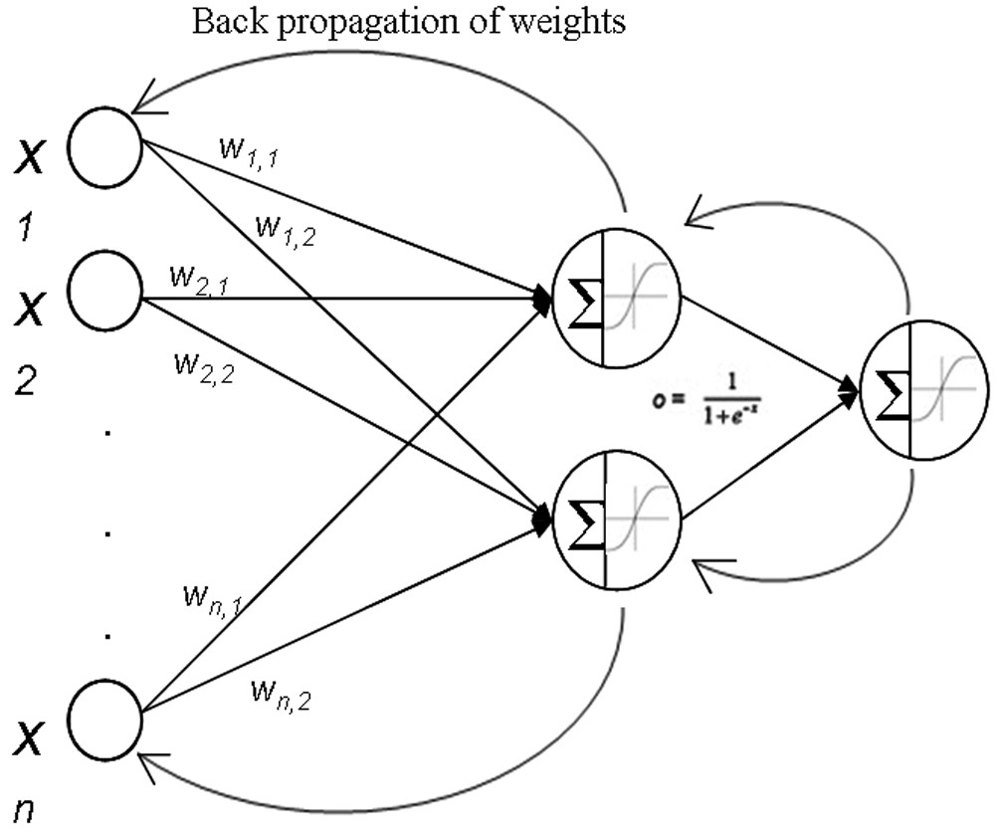
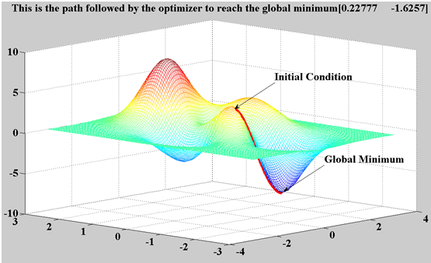
Logistic Activation Function
Readjust weights

Slide 10
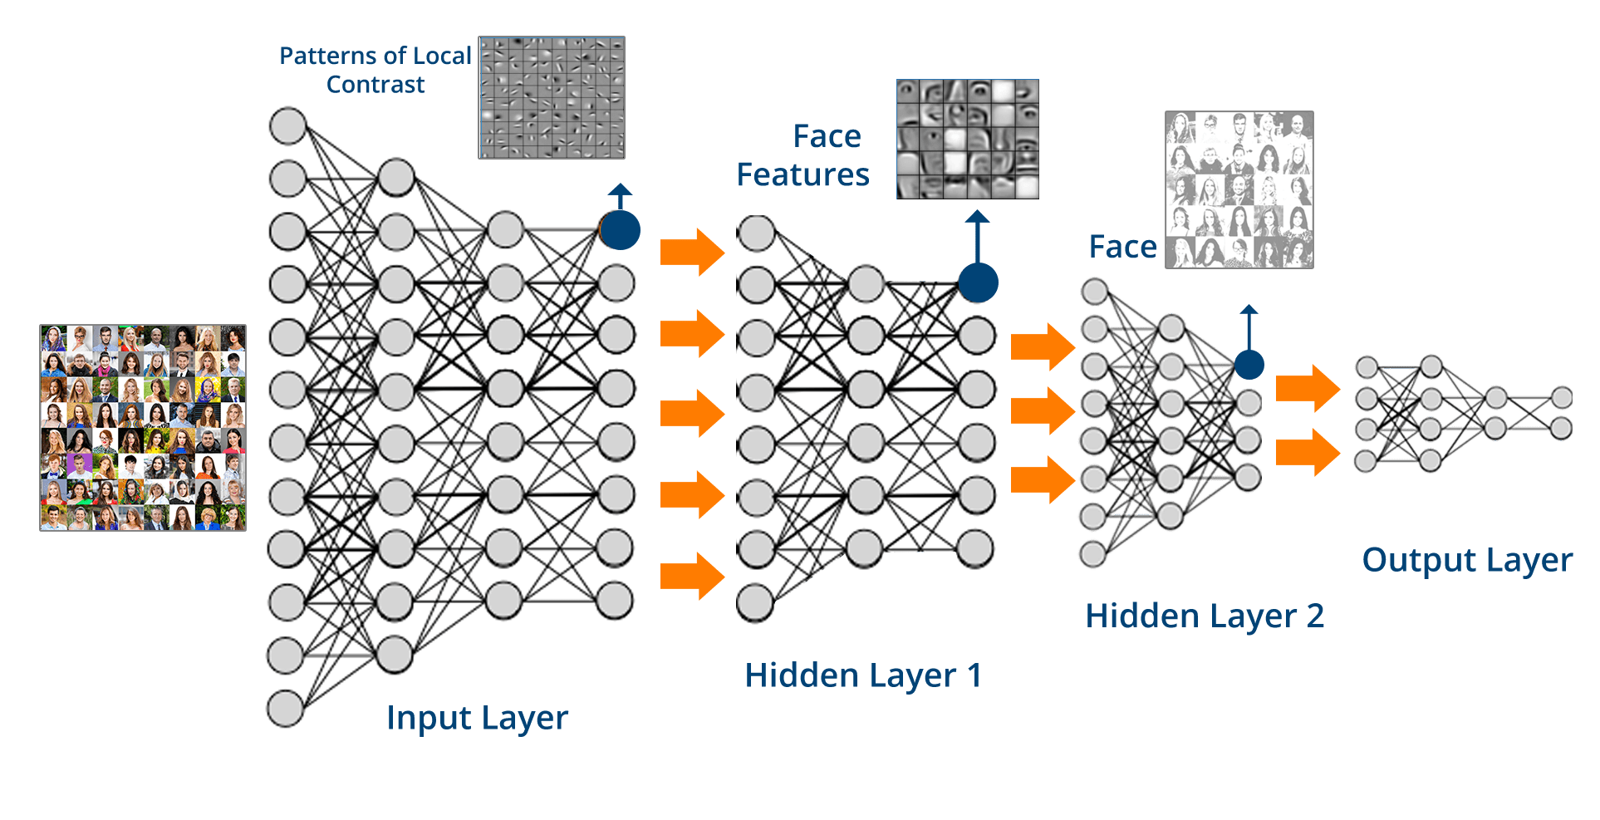
A multilayer perceptron (MLP) is a feedforward artificial neural network model that maps sets of input data onto a set of appropriate outputs. A MLP consists of multiple layers of nodes in a directed graph, with each layer fully connected to the next one. Except for the input nodes, each node is a neuron (or processing element) with a nonlinear activation function. MLP utilizes a supervised learning technique called backpropagation for training the network. MLP is a modification of the standard linear perceptron and can distinguish data that are not linearly separable.

Slide 11
Histopathologic Cancer Detection
https://www.kaggle.com/c/histopathologic-cancer-detection
Notes:
*Kaggle, an online community of data scientist designed to allow exploration of industry tools and techniques.
*Offers ranked machine learning competitions, where individuals with the best results can earn prizes or rewards.

Slide 12
Notes:
*270,000 images
*images are provided as a modified version of the larger PatchCamelyon or Pcam benchmark dataset.
*Each image is small a patch of a much larger digital pathology scan or Whole slide image (WSI).
*Additionally, we are provided with a train_label.csv that includes the unique id and corresponding indicator if an image contains a tumor issue.

Slide 13
Data Structure and Pipeline
Notes:
*We’ve seen several example images, lets dive into the data and get an idea of what we are provided.

Slide 14
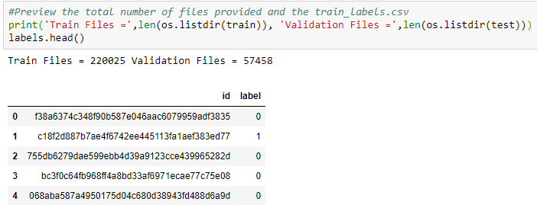
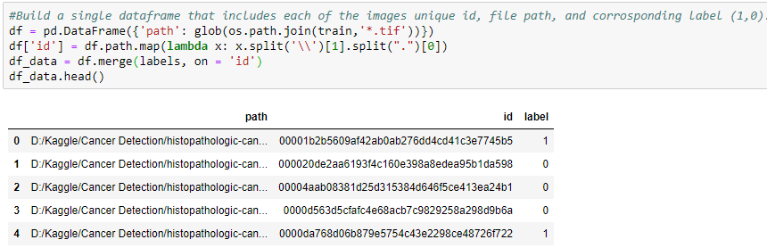
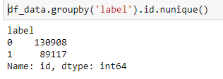
1 = Has Tumor Issue
0 = No Tumor Issue
Naive Assumption = 40%
Notes:
*Using jupyter notebook and pandas dataframes to explore.
*Bias in Neural nets (60/40)
*Random sample of both groups (80,000)
*Training dataset = 160,000

Slide 15

Train Directory (160,000 Images)
Train Set (144,000 Images)
Test Set (Holdout 16,000)
Model
Kernel Crash
Notes:
*Train_Test_Split (Holdout 10%)
*Attempting to load all images via data frame fails due to constraints with memory

Slide 16
Train Directory (160,000 Images)
Train Sub-Directory (144,000 Images)
Validation Sub-Directory (Holdout 16,000 Images)
Training_Has_Tumor_ Tissue (72,000 Images)
Training_No_Tumor_Tissue (72,000 Images)
Validation_Has_Tumor_ Tissue (8,000 Images)
Validation_No_Tumor_ Tissue (8,000 Images)
Model
Keras Image Preprocessing:
Datagen.flow_from_directory
Weights

Slide 17
Conceptualize and Build our Model
Notes:
*Build the model using the Tensorflow open source machine learning library and the keras api
*Keras – allows us to quickly test and experiment with our model

Slide 18

Image Dimensions
96x96x3
Feature Map
Source: http://machinelearninguru.com/computer_vision/basics/convolution/convolution_layer.html
Notes:
Feature map allows us to recognize high level features in our images.

Slide 19
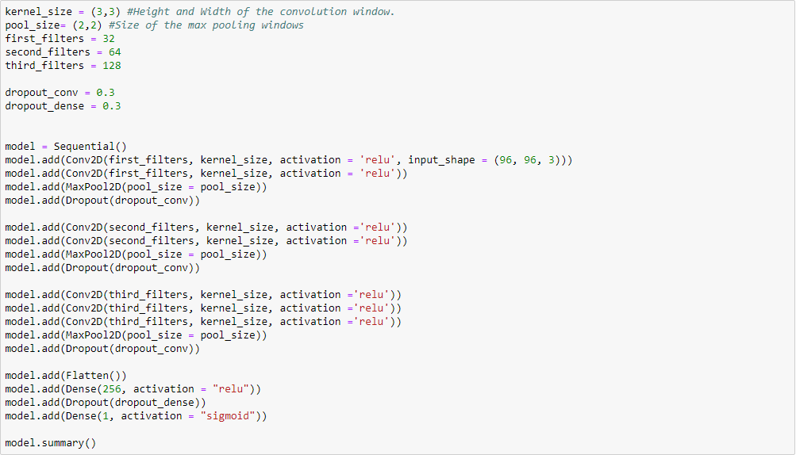
Notes:
Modeled after VGGnet.
7 convolution layers.
3 pooling layers.
Activation function (relu) – Rectified linear unit. Take the max of 0 and the output from the corresponding layer.
1 fully connected layer – attempt to learn non-linear relationships between our high-level features
Connected layer utilizes the sigmoid activation function to return the final weights -1/1

Slide 20
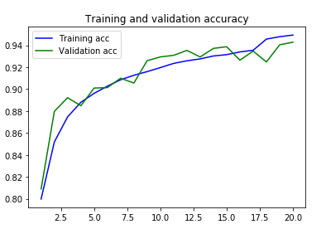
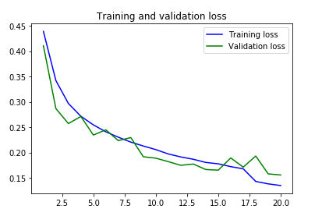
Notes:
Binary Cross Entropy Loss function (Negative Log loss).

Slide 21
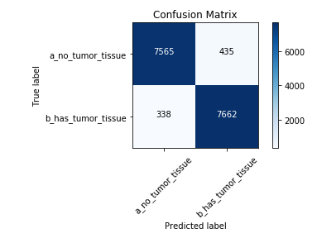
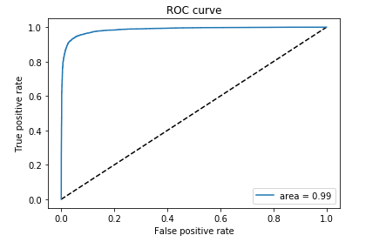
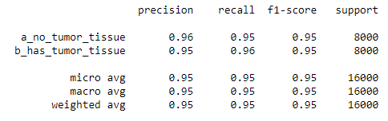
Model Validation
AUC = 0.989
Notes:
Precision - (accuracy/sensitivity) – Of all the images we classified, how accurate were we? (95%)
Recall – Of all of the images with the corresponding labels, how many did we capture? (96%)
ROC Curve = .99 Maximize the area under the curve with respect to the true and false positive rate

Slide 22
Appendix
Stanford CNN Overview - http://cs231n.github.io/convolutional-networks/
Public Kernel Referenced - https://www.kaggle.com/vbookshelf/cnn-how-to-use-160-000-images-without-crashing
Keras Documentation - https://keras.io/

Slide 23
